Slide 1

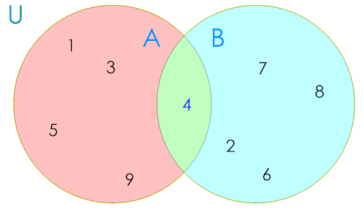
Sets-project
By TEAM: technical knockout

Slide 2

About the team
Code checker – Alexander Hristov
Scrum trainer – Dimitar Kalchev
Front-end Developer– Martin Atanasov
C++ developer – Ivan Dimov
C++ developer – Tsvetan Tinev

Slide 3
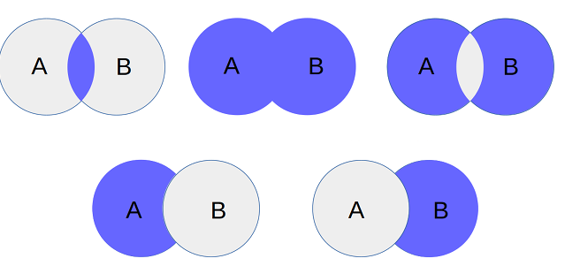
Resume
The purpose of the project is to help using the operations which can be done with sets. In the program there are some of the operations. Here is a list of them:
Union
Section
Difference
Subset
Symmetric difference

Slide 4
Resume
In our project, we use files that save data entered by the user. The data is then processed so that it can be used in order to display different actions with sets.

Slide 5




Used technologies
Programming language – C++
Main IDE – Visual Studio 2019
Version-Control Platform - Github

Slide 6
LET'S MOVE ON TO THE CODE

Slide 7
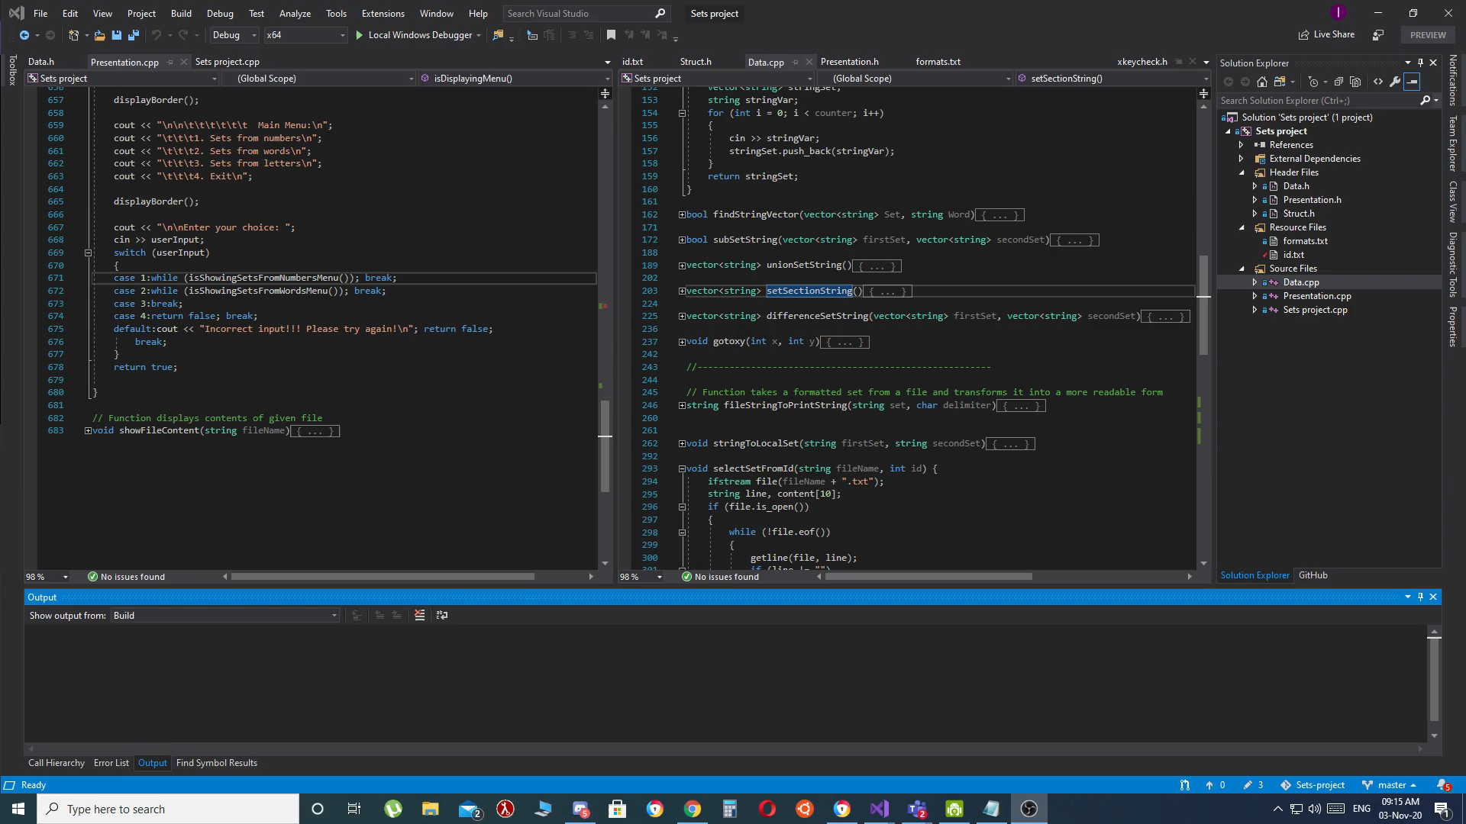
video

